Slide 1











Presentation
Columbia
Asia Hospital
Analysis
Achal Zalke

Slide 2

Problem Statement
“ You have been hired as a consultant data analyst by Columbia Asia Hospital. The Hospital is looking for key insights for the following objectives:
Assess the hospital's revenue generation
Insights about suitable departments for new hires
Strategies suggestions for patient discounts
Your task is to perform data analysis and come up with a report in order to help the organization with the mentioned objectives. “

Slide 3
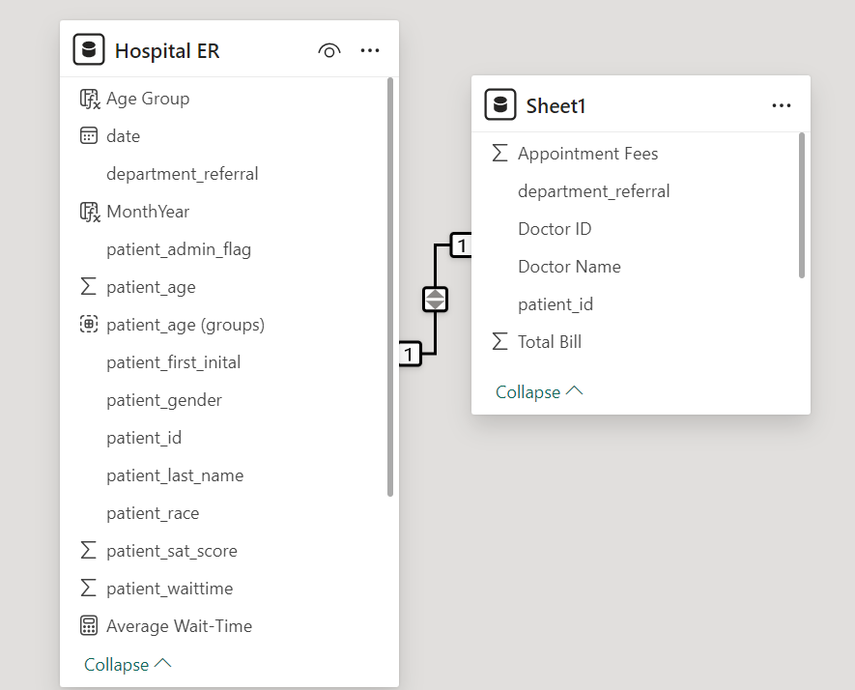
Overview Of The Dataset
No. of Tables: 2
9216 Rows in Table ‘Hospital ER’
9216 Rows in Table ‘Sheet1’
7 Departments [General, Orthopedics, Physiotherapy, Cardiology, Neurology, Gastroenterology, Renal]
7 Patient Race Categories [White, Black, Multiracial, Asian, Pacific Islander, Native American, Declined to Identify]

Slide 4

About
Columbia Asia Hospital
A well-known healthcare facility, Columbia Asia Hospital is a shining example of patient-centered care and medical expertise. The hospital is well-known for its dedication to offering top-notch medical care and has a global presence in several nations. Modern infrastructure, state-of-the-art medical technology, and a staff of highly qualified and caring healthcare professionals define Columbia Asia. In order to address the many requirements of the communities it serves, the hospital's ethos is centered on providing complete and individualized healthcare solutions. Columbia Asia Hospital is committed to providing excellent medical care and promoting a healthy and prosperous society. It has achieved this by adopting a patient-centric approach.

Slide 5
Summary
A dataset from Columbia Asia Hospital was carefully analyzed and guaranteeing data integrity. We looked at popular departments, typical wait times, and patient groups' patterns of healthcare use. We looked at patient trends and determined many different types of aspects by using DAX functions. We looked at how wait times and satisfaction levels relate to one another, how departmental visits are affected by demographics, and how to handle discrimination complaints. We examined the General Practice department's profitability, waiting time variations, recommended discount assignment, and doctor shift alignments. We demonstrated our technical expertise in adding columns to Power Query using M-query and Power BI Gateway. The hospital's strategic decision-making, patient experience advancements, and operational improvements are informed by the insights obtained.

Slide 6


Analytical Approach and Tools
Data Transformation and Cleaning
Used Power Query Editor in Power BI to transform and clean data. Handled missing values and inconsistencies to ensure data integrity.
Power Query Editor
Used Power Query Editor to shape and clean the Data. Carried out tasks including sorting, filtering and merging to improve the quality of Dataset.
DAX Functions
Employed DAX Functions for numerical measurements, such as Average, Sum, IF, IFBlank, Calculate, Switch, Max, Count.
Visualizations
Created interactive dashboards and reports using Power BI's visualizations. Implemented charts, tables, and tabular views for effective data presentation.
Strategic Decision-Making
Helped with strategic decision-making by offering useful insights and conducting patient demographic analysis. Computed departmental revenues and average waiting times using DAX tools.

Slide 7
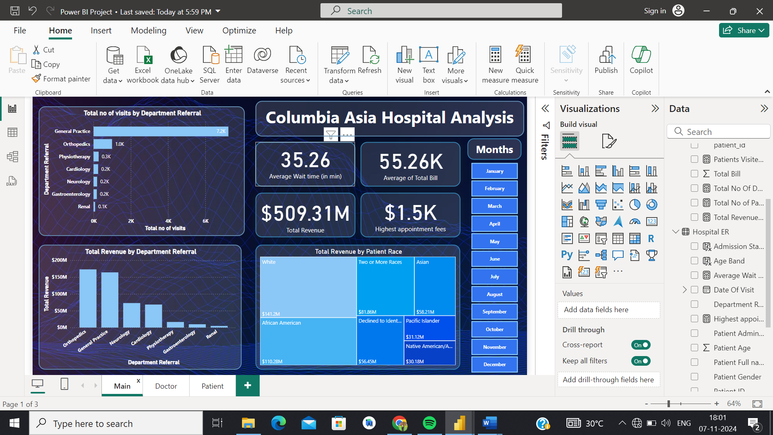
Total Visits by Department
The distribution of patient visits across the various departments can be seen in the bar chart, which makes the following visit counts visible: With 7.2k visits, general practice is the most popular, followed by orthopedics (1.0k), physiotherapy (0.3k), cardiology (0.2k), neurology (0.2k), gastroenterology (0.2k), and Renal (0.1k). With General Practice getting the most visits and Orthopedics coming in second, this graph clearly illustrates the relative popularity of each department and offers insightful information for the hospital's resource allocation and strategic planning.

Slide 8
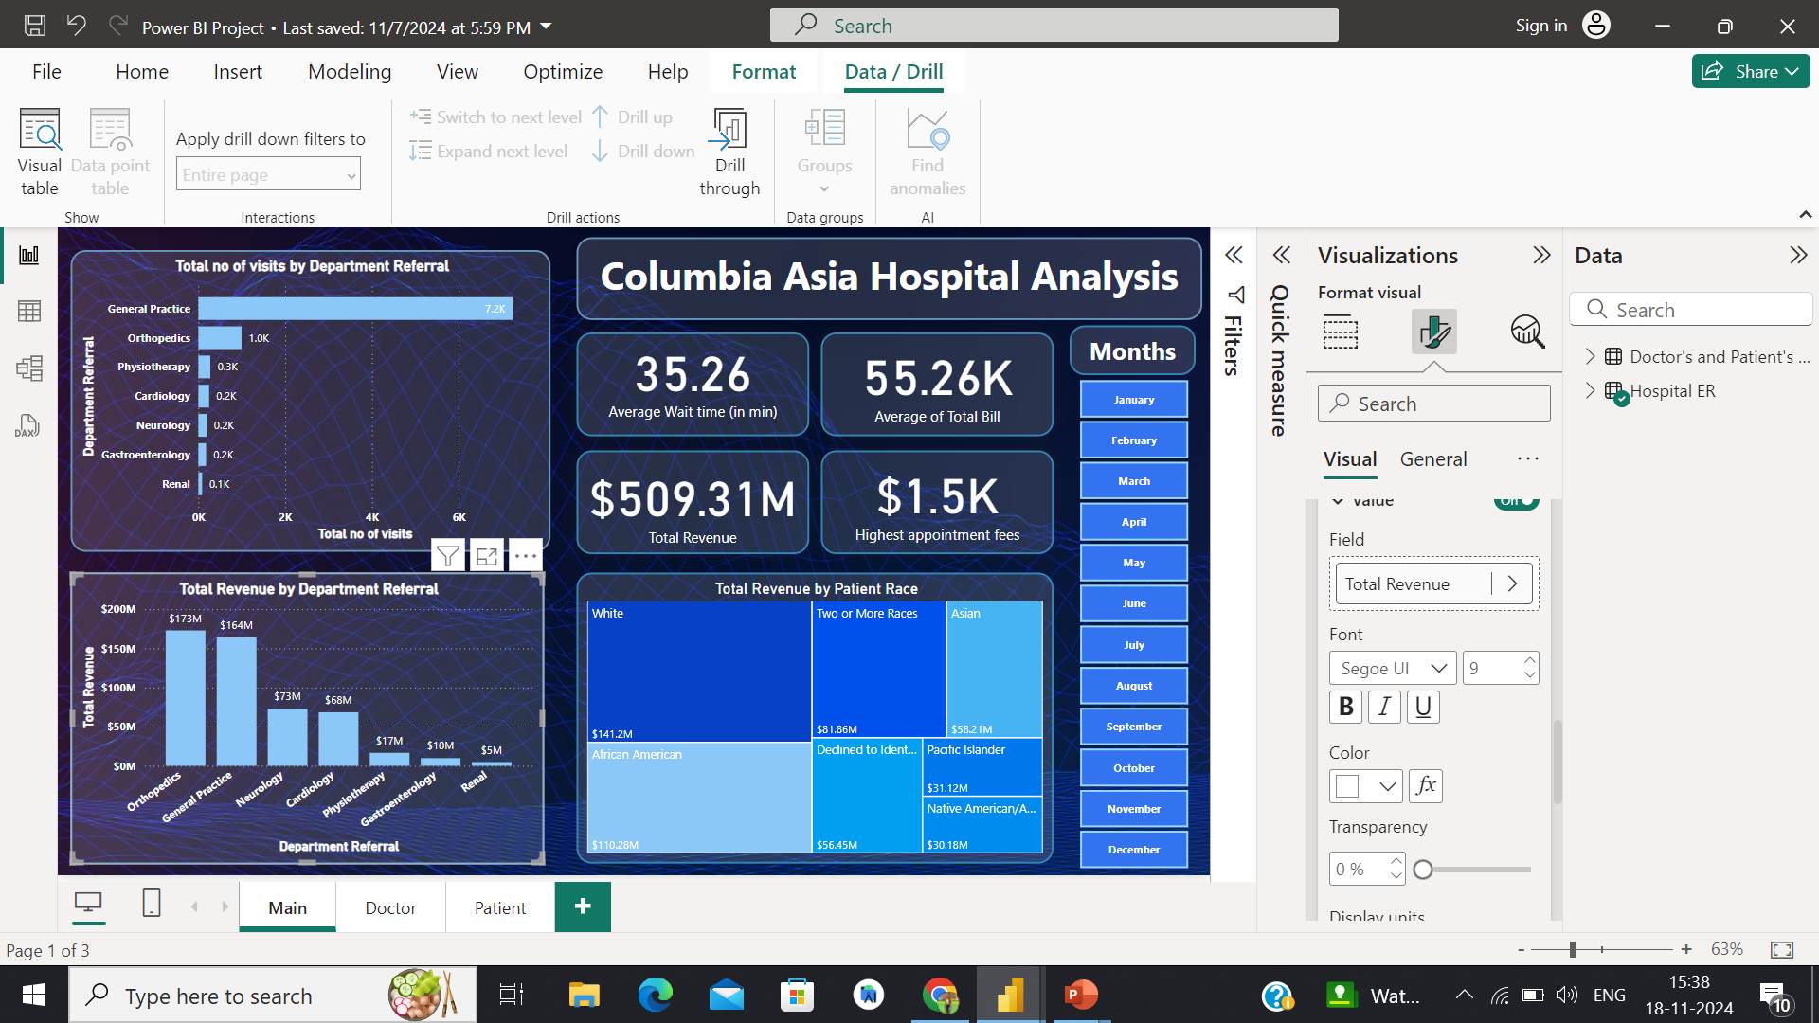

Total Revenue
Overall Revenue Earned
$509.3M
The departmental revenue appears in a column chart that highlights significant contributions. With $172.9M, Orthopedics is the largest, closely followed by General Practice at $164.1M. Contributions from cardiology and neurology are $73M and $68.4M, respectively. Gastroenterology, physiotherapy, and renal come next with $17M, $9.8M, and $5M, respectively. Within the hospital, this succinct depiction facilitates resource allocation and strategic decision-making.

Slide 9

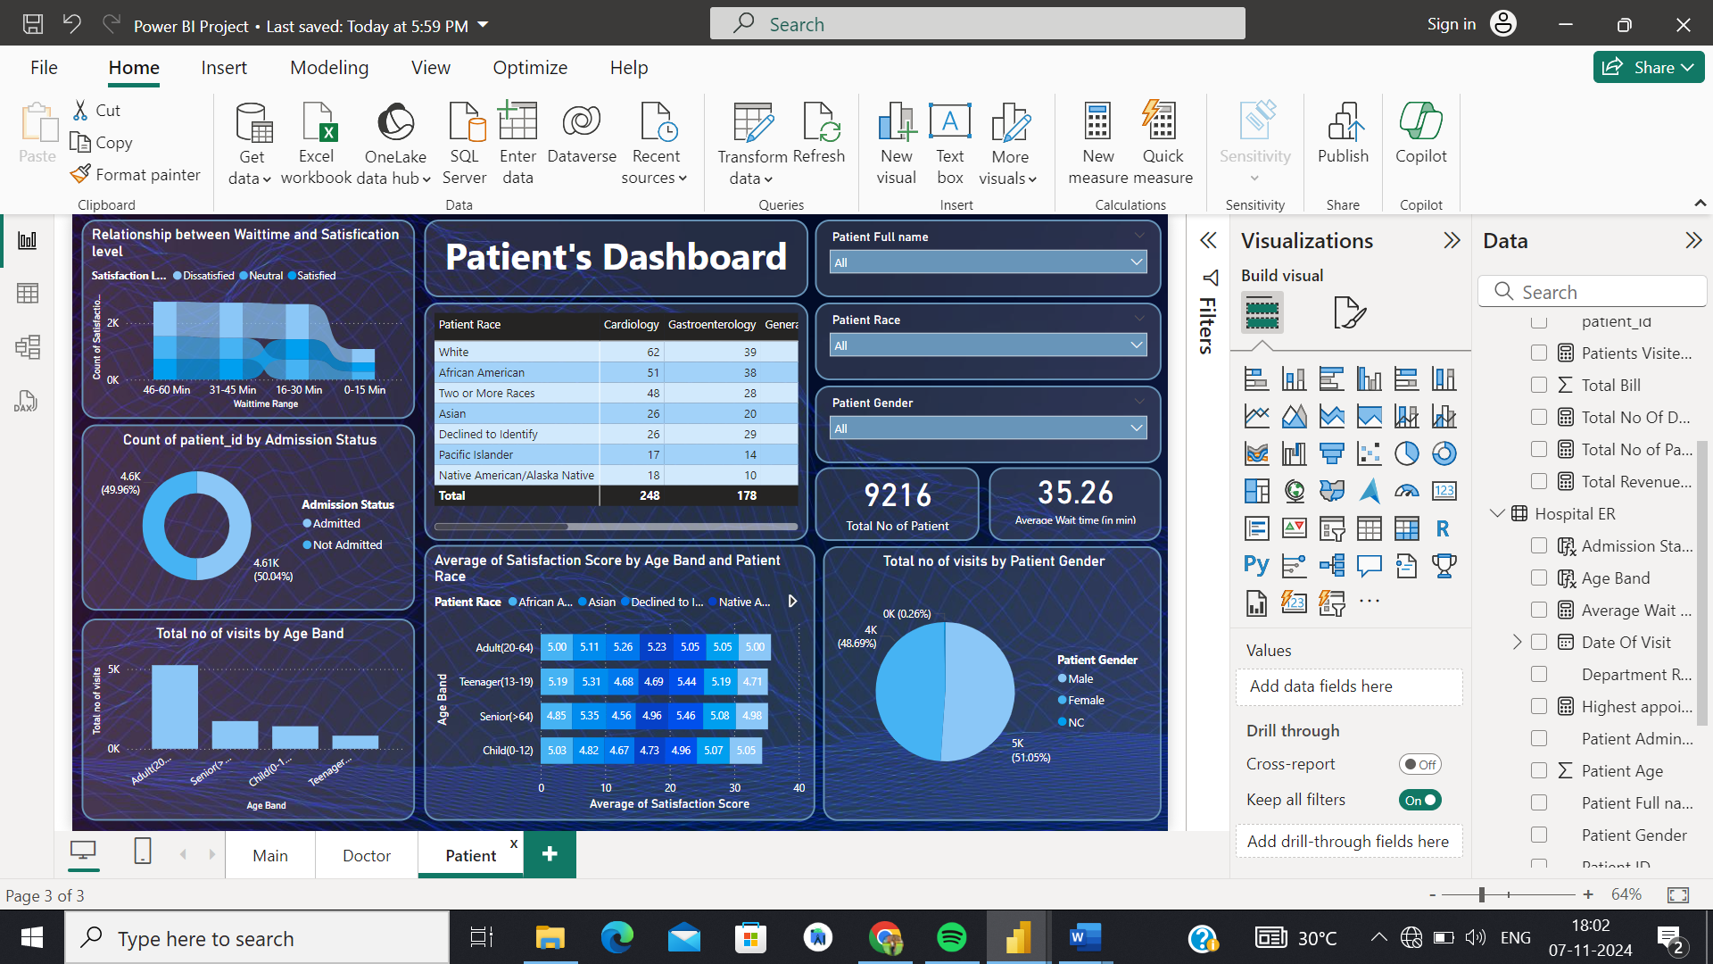

Gender Preference
The gender distribution of hospital visits appears to be equal in the pie chart, with 51.1% (4705) of hospital visits being made by men and 48.9% (4487) by women. This fair representation highlights the hospital's welcoming atmosphere that serves a wide spectrum of patients.
4705
4487

Slide 10

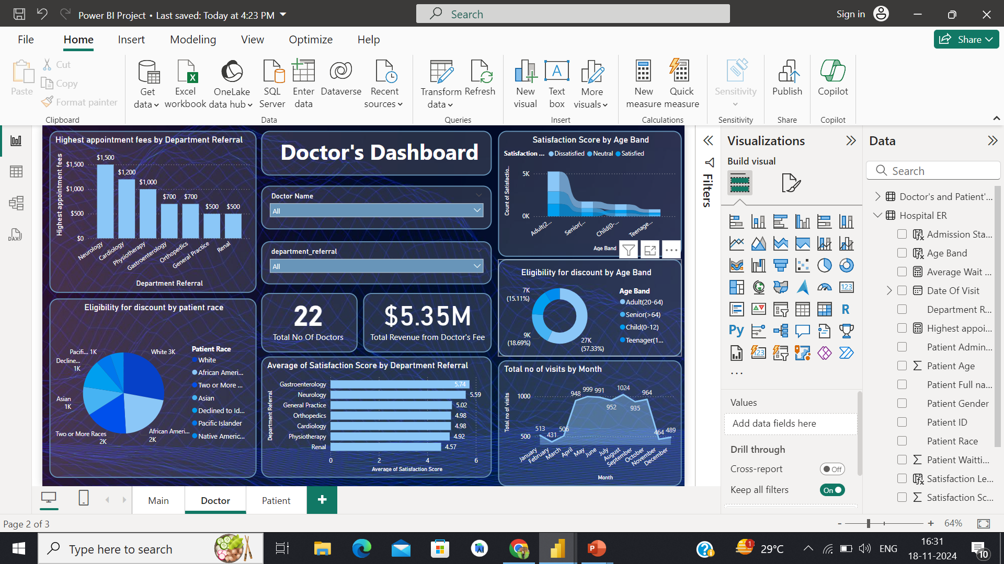
Average Satisfaction
Satisfaction Scores every departments received
Recommendations
• Gastroenterology leads with a strong 5.9 average satisfaction rating.
• Neurology and Physiotherapy follow closely at 5.6.
• Orthopedics and General Practice are slightly behind with 5.5.
• Cardiology and Renal exhibit ratings of 5.4 and 5.3, respectively.
To improve overall satisfaction, focus on enhancing ratings in Cardiology and Renal departments.
Implement targeted improvements, gather regular feedback, and foster a patient-centric culture.
Continuous efforts in addressing specific concerns will contribute to overall patient satisfaction.

Slide 11
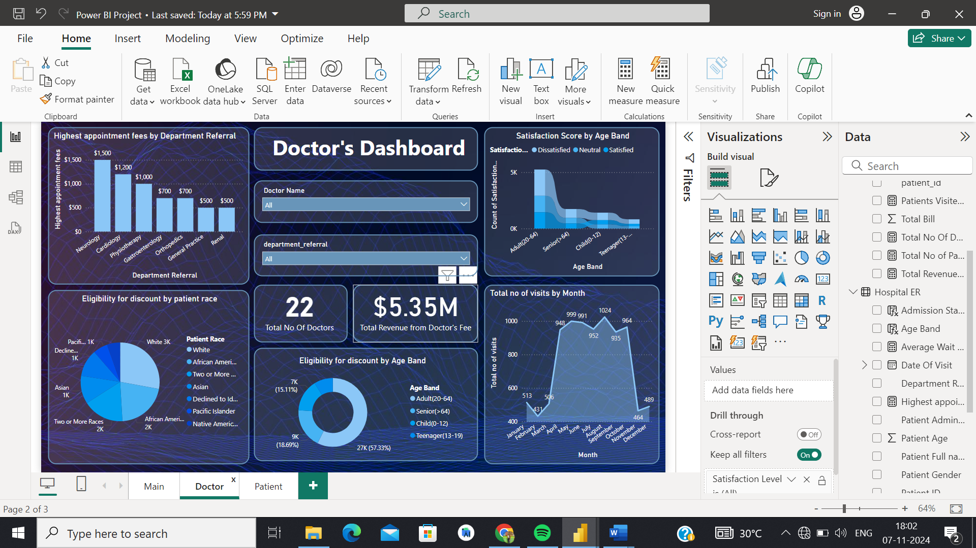

Appointment Fees
Total Doctors in Hospital
22
The appointment fees that doctors charged varied depending on the departments in which they worked.
Let's review the fees that these departments charge. The department with the highest fee of all is neurology, which charges $1,500. The departments with the lowest fees were General Practice and Renal ($500), Gastroenterology ($700), Orthopedics ($700), Cardiology ($1200), and Physiotherapy ($1000).

Slide 12

Visits in Months
Certainly, there has been a sudden increase in the number of patient visits from April to October. Patient volume is relatively lower during January to March and in November to December.

Slide 13
Revenue by Race
Overall Revenue Earned
$509.3M
The racial revenue appears in a treemap chart that highlights significant contributions. With $141.2M, White is the largest, closely followed by African American at $110.28M. Contributions from two or more races and declined to identify are $81.86M and $56.45M, respectively. Asian, Pacific Islander and Native American/African come next with $58.21M, $31.12M, and $30.18M, respectively.

Slide 14
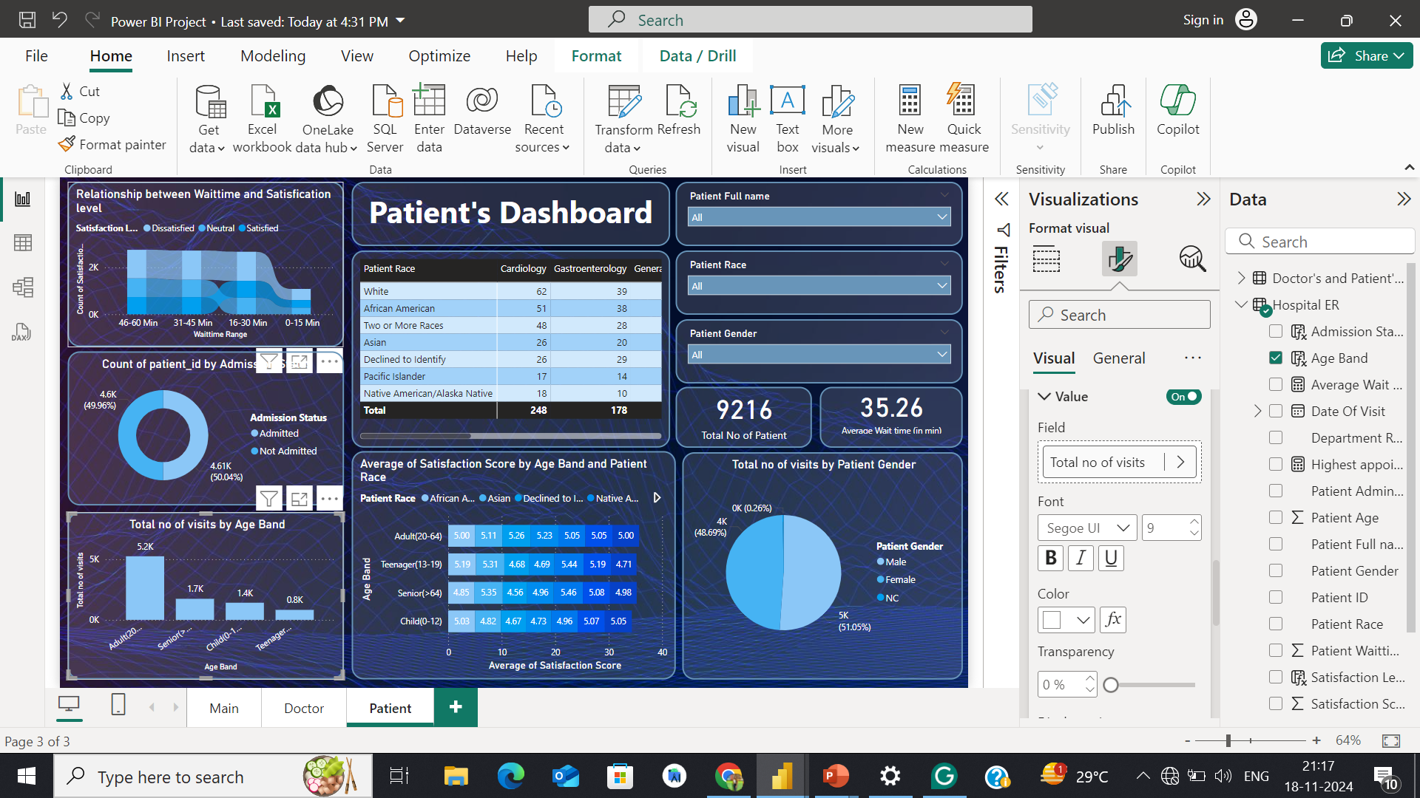

Visits By Age group
The no of visits by Adults (20-64) are 5.2k ,by senior(>64) are 1.7k ,by child are 1.4k and by teenagers(13-19) are 0.8K . Adults have the highest number of visits and teenager have lowest number of visits

Slide 15
Recommendations
1. Based on Satisfaction Scores: Patients who have reported low satisfaction scores should be prioritized for discounts.
2. Based on Demographic Factors: Elderly patients, who often require more frequent visits and treatments, could be offered discounts to reduce their financial burden.
3. Based on Frequency of Visits: Patients who visit frequently could be rewarded with discounts as a form of loyalty incentive. E.g., after a certain number of visits, a patient might receive a discount on their next visit.
4. Target High-Cost Departments: Patients who frequently visit departments associated with high costs (e.g., oncology, surgery) might benefit from discounts to reduce financial strain.
5. If the hospital budget permits, it is advisable to explore the option of recruiting additional doctors for the General Practice department. Currently, this department accommodates the highest volume of patients with only three doctors.

Slide 16
Dashboard and Visualizations
Main Tab
On this tab Hospital will be able to view all the metrics like number of daily visits, revenue produced, Satisfaction.
Added a Slicer of Months from which we will be able to see the results according the particular month.

Slide 17
Dashboard and Visualizations
Doctor’s Tab
Individual doctor’s performance metrics will be visible here like customer satisfaction, number of patients visited, revenue generation.
I have added slicer of doctor’s name to view metrics as per every doctor,and one more slicer of department.

Slide 18
Dashboard and Visualizations
Patient’s Tab
This tab is built for viewing the customer’s profile which will be including some metrics like Department visited, age, race, gender, Total amount they have paid, etc.
I have added slicer of patient’s individual id to view profile as per every patient, patient’s race, patient gender for detailed analysis

Slide 19
Conclusion
Through comprehensive analysis, we derived critical insights to aid Columbia Asia Hospital's strategic decision-making. Key findings include:
Department Performance: General Practice and Orthopedics are the top-performing departments in terms of patient visits and revenue.
Revenue Contributions: Orthopedics and General Practice are leading contributors, while Neurology commands the highest appointment fees.
Demographic Trends: Adults (20–64) form the largest patient group, and a balanced gender distribution reflects inclusivity.
Satisfaction Insights: Targeted improvements in Cardiology and Renal departments can enhance overall patient satisfaction.
Strategic Recommendations: Focus on optimizing resource allocation, tailoring discounts for underperforming departments, and aligning doctor schedules with patient trends.
These findings and strategies are designed to enhance patient experience, improve operational efficiency, and boost revenue generation, ensuring the hospital continues to deliver exceptional care.

Slide 20

Thank You

